Slide 1

Content-based retrieval from digital video
主講人：劉邦渝
日期：91.06.04

Slide 2
Reference
Volker Roth. Content-based retrieval from digital video. Image and Vision Computing, special issue on Content-Based Image Indexing and Retrieval, 17(7):531-540, May 1999. ISSN 0262-8856.

Slide 3
Outline
Introduction
Content-based retrieval in general
Framework
Conclusion

Slide 4
Introduction
Electronic document processing has allowed simple and easy storage of documents---which has led to a sea of documents. This makes finding a particular bit of information rather hard.
When database became “multimedia” aware---mostly by adding images to the databases contents. This may cause harder finding.

Slide 5
The first query approach was to annotate the images with text and use the annotations as a basis for retrieval.
Next is Content-based retrieval which in order to extract intrinsic image features suitable for automatic indexing and retrieval.
These features are used to reduce the complexity of image comparisons and to improve the organization of image database.

Slide 6
Unfortunately, automatic retrieval of suitable features is very hard.
After all, content-based retrieval is meant to be for humans, and not for computers.
We chose semantic networks to present video contents on a high level of abstraction.

Slide 7
Content-based retrieval in general
Since content-based retrieval is to support humans, the judgment of what the content is and which contents are similar should deliver the same results that human judgment does.
For content-based retrieval, basically the following types of queries can be identified:

Slide 8
Directly
The user knows exactly what he is searching for.
2. By similarity
The user selects one or several documents which are “similar” to the kind of document that he is searching for.
By prototype
Related to 2. This representation is matched against the database’s contents using a similarity measure.

Slide 9
One additional retrieval mechanism should be provided is browsing.
Ideally the browsing mechanism should work together with the retrieval mechanisms mentioned before so that user can browse the whole database as well as the results of query.

Slide 10
The presentation of query results is also important. Rather than displaying full version of the retrieved documents, significant representations of them should be used instead.

Slide 11
Framework
For a readily explortable framework for content-based video retrieval we decided to use semantic network for the representation of video content.
A semantic network is one knowledge representation among a variety of possible others. The basic assumption is that semantically related concepts are connected by associative links. This model is usually called associative memory model.

Slide 12
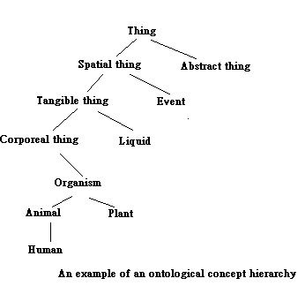
Concepts are linked simultaneously in a class hierarchy as well as to concepts to which they are related.

Slide 13
Basically, two approaches exist for query semantic networks: subnet matching and spreading of activation.
Subnet matching:
Queries to a semantic network representation are mapped onto a query-network.
The mapping process tries to determine if the query-network is a subnet of the semantic network by matching nodes and links.
If it can be made equal to a subset of the semantic network the query is answer ‘yes’, otherwise ‘no’.

Slide 14
Spreading of activation:
It is able to determine paths between arbitrary nodes of a network.
Starting from the nodes activated by a query, activation is propagated to the direct neighbors. This process is iterated for the neighbors and their neighbors and so forth.
This is similar to the algorithm for finding the shortest path in a graph theory.

Slide 15
Conclusion
This paper propose a framework for content-based video retrieval which might enable the unison of various efforts in this area.
It satisfies the demand for a semantic representation of video content and a query mechanism that are based on a model of human cognition.

